Slide 1
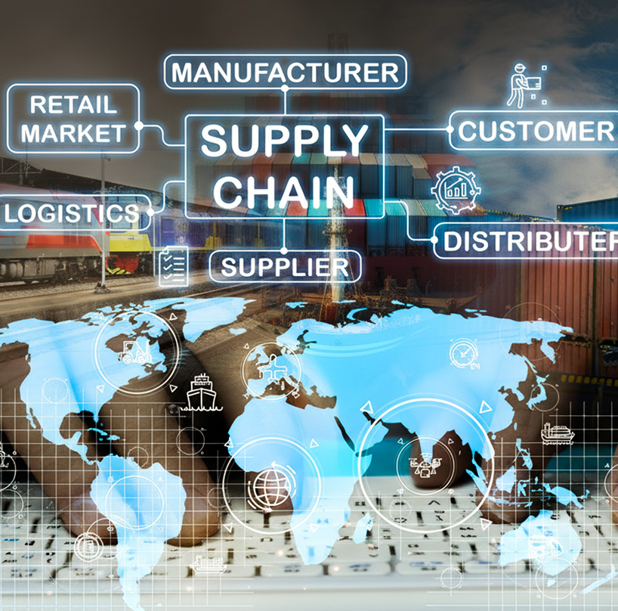


Supply Chain
R3-Data Analyst Specialist CAI3_DAT1_G1
Instructor
Eng. Ahmad Samir
Team
Mervat Abdel-Atty Mohammed
Doaa Abd-Ellatif Mahmoud
Reham Hesham Salah
Monica Ibrahim Rezkalla
Omar Ahmed Fahmy

Slide 2
Supply chain
The process of getting a product or service from its origin to the final consumer. It includes the network of all the organizations, people, activities, information, and resources involved.

Slide 3
Agenda
Domain Knowledge
Dataset Description
Data Cleaning
Normalization
Analysis Questions
Visualization
Conclusions and Recommendations

Slide 4

1
Domain Knowledge
We did 2 main steps:
1- Searching:
To understand the business context and the dataset. Identifying key variables such as inventory levels, order quantities, lead times, supplier performance, costs, revenue.
2- Many discussions with Instructor:
To guide us to fill gaps in data to highlight the main KPIs (key analytical questions) that can be extracted (meaningful insights)

Slide 5







2- Dataset Description
No of Order Quantity 4922
Orders 100
Products Types
- Transportation Modes
- Routs
- Defect Rete
- Inspection Results
Orders
Suppliers
Carriers

Slide 6
2- Dataset Description
Haircare
Skincare
Cosmetics
Products Types
Orders
Suppliers
Carriers
- Transportation Modes
- Routs
- Defect Rete
- Inspection Results

Slide 7
2- Dataset Description
100 Products
23 Variables
100 Orders
34 Haircare
40 Skincare
26 Cosmetics
Suppliers
Carriers
- Transportation Modes
- Routs
- Defect Rete
- Inspection Results
Products Types
Orders

Slide 8
2- Dataset Description
Cites:
Mumbai 22
Kolkata 25
Delhi 15
Bangalore 18
Chenni 20
5 suppliers:
Supplier 1
Supplier 2
Supplier 3
Supplier 4
Supplier 5
3 carriers
A - B - C
Suppliers
Carriers
- Transportation Modes
- Routs
Products Types
Orders
- Defect Rete
- Inspection Results

Slide 9
2- Dataset Description
Air
Sea
Rail
Road
A – B - C
Suppliers
Carriers
- Transportation Modes
- Routs
- Defect Rete
- Inspection Results
Products Types
Orders

Slide 10
2- Dataset Description
Defect Rate:
Min .02
Max 4.9 Average 2.3
Inspection Results:
Pass 23%
Fail 36%
Pending 41%
Suppliers
Carriers
- Transportation Modes
- Routs
- Defect Rete
- Inspection Results
Products Types
Orders

Slide 11


Steps
3
Data Cleaning
Three Tools were used as Follows:

Slide 12
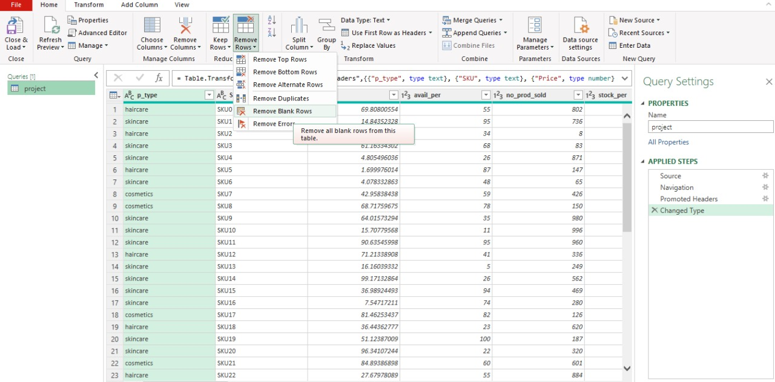
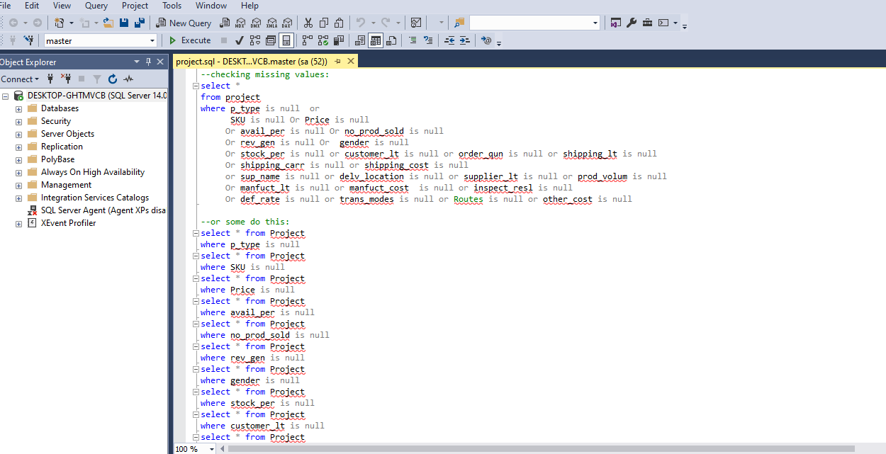
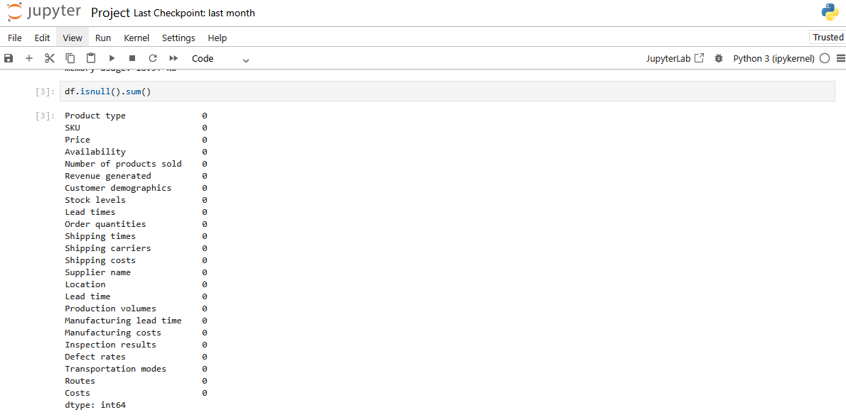
No missing values
(Excel – Python -SQL)
1

Slide 13
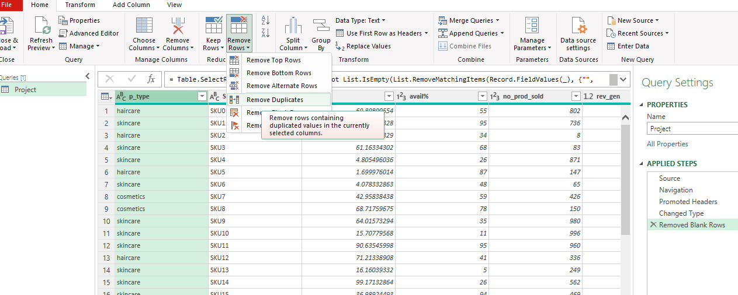
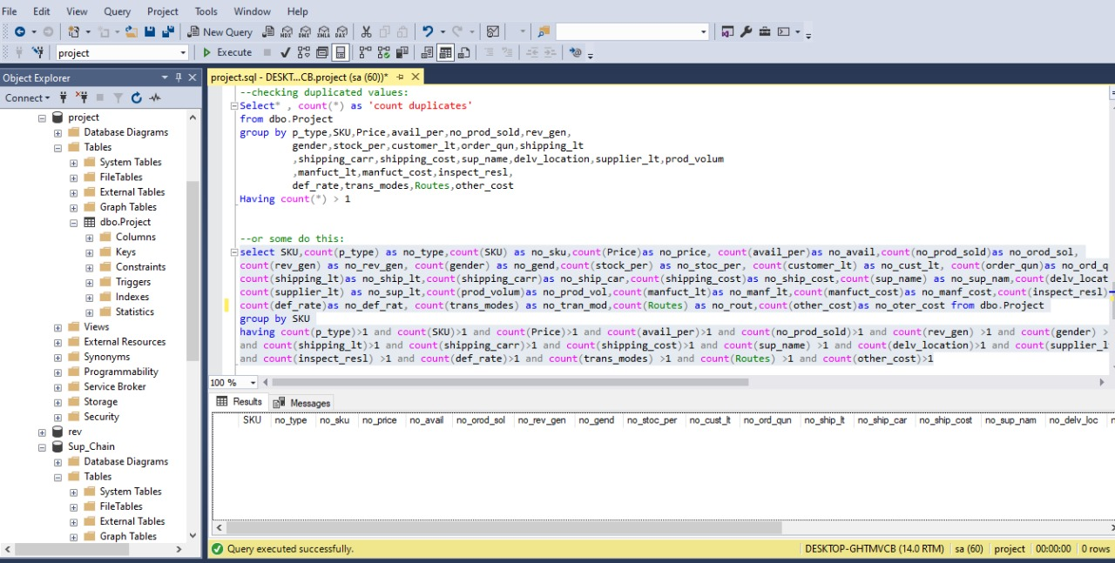
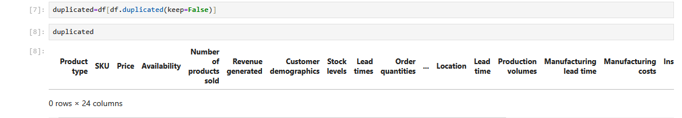
No duplicated rows
(Excel – Python -SQL)
2

Slide 14
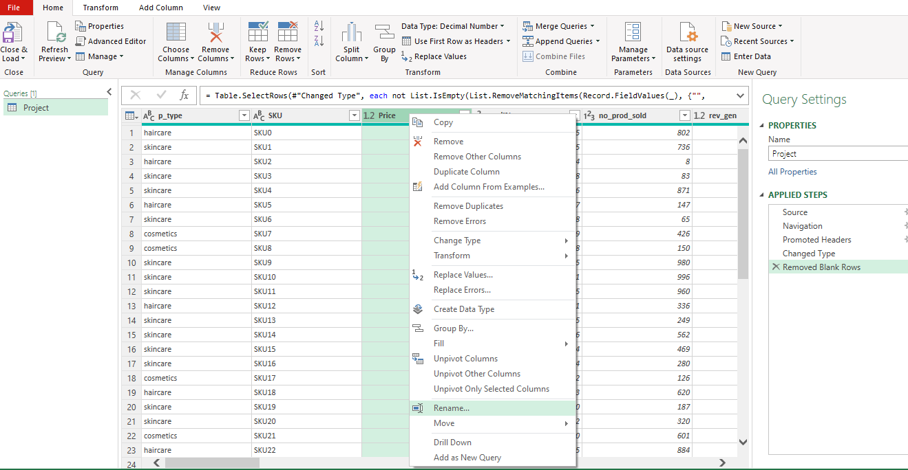
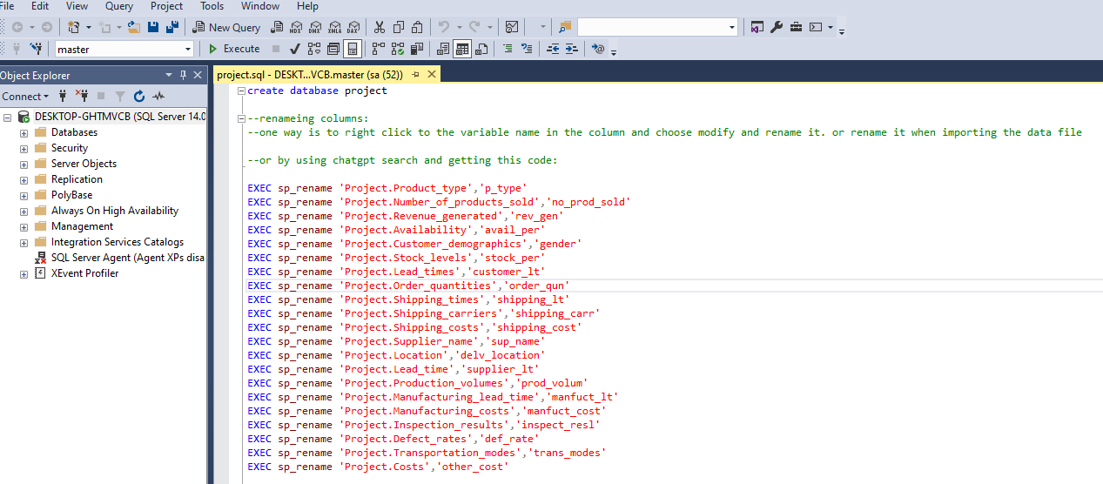
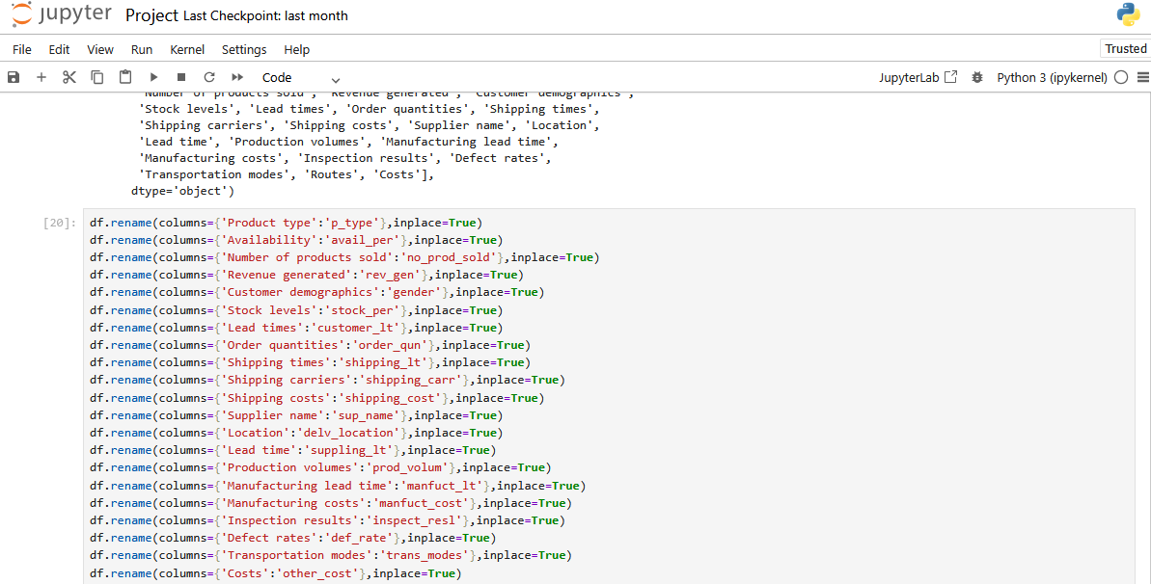
3
Renaming
Variables
(Excel – Python -SQL)

Slide 15
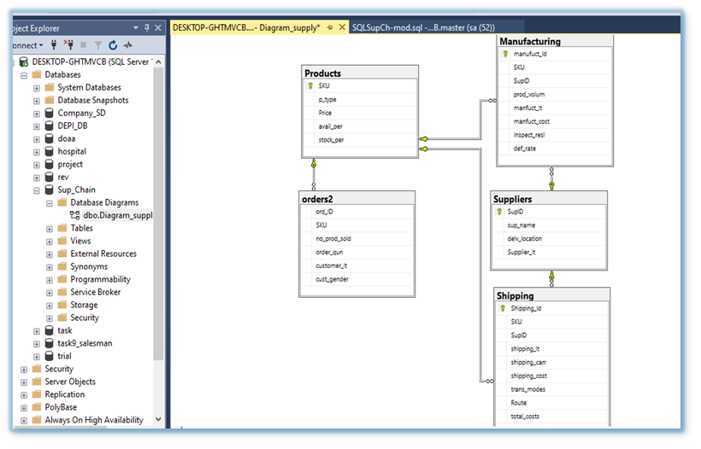
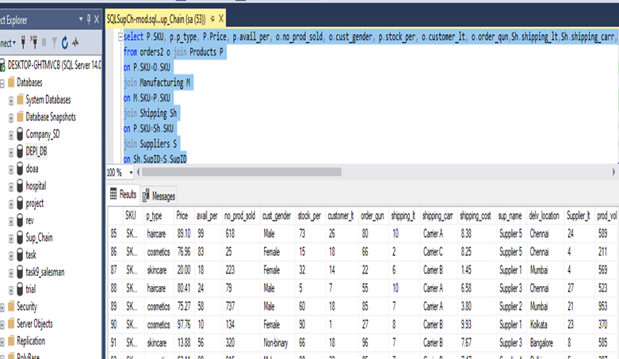

4
Normalization

Slide 16


5
Analysis Questions
Main Goal: deliver the correct orders to right place on time with no errors or returns with low costs to get higher customer satisfaction.

Slide 17
2
1
4- Analysis Questions
3
Efficiency of Inventory Management service level (stock – availability).
Third Title
Secand Title

Slide 18

4- Analysis Questions
2
1
3
Efficiency of Inventory Management service level (stock – availability).
we can achieve our main goal By ……
Third Title
Secand Title

Slide 19



we can achieve our main goal By ……
2
1
3
Evaluation of Suppling and Shipping (Time: lead Time - Cost: Costs - Product Quality: Defect Rate, Inspection Result).
Efficiency of Inventory Management service level (stock – availability).
Financial Evaluation: revenue

Slide 20






Which product type offers the best inventory availability and the strongest financial performance?
1
2
Who tends to purchase more: males or females?
4 Analysis Questions
3
Which supplier demonstrates the best overall performance?
4
Which Carrier provides the most reliable service?
5
Which Transportation mode is the most efficient?
6
Which route provides the best overall performance?

Slide 21
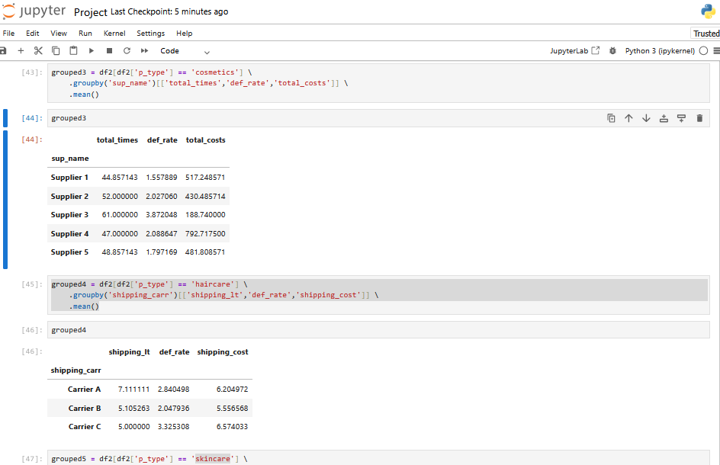
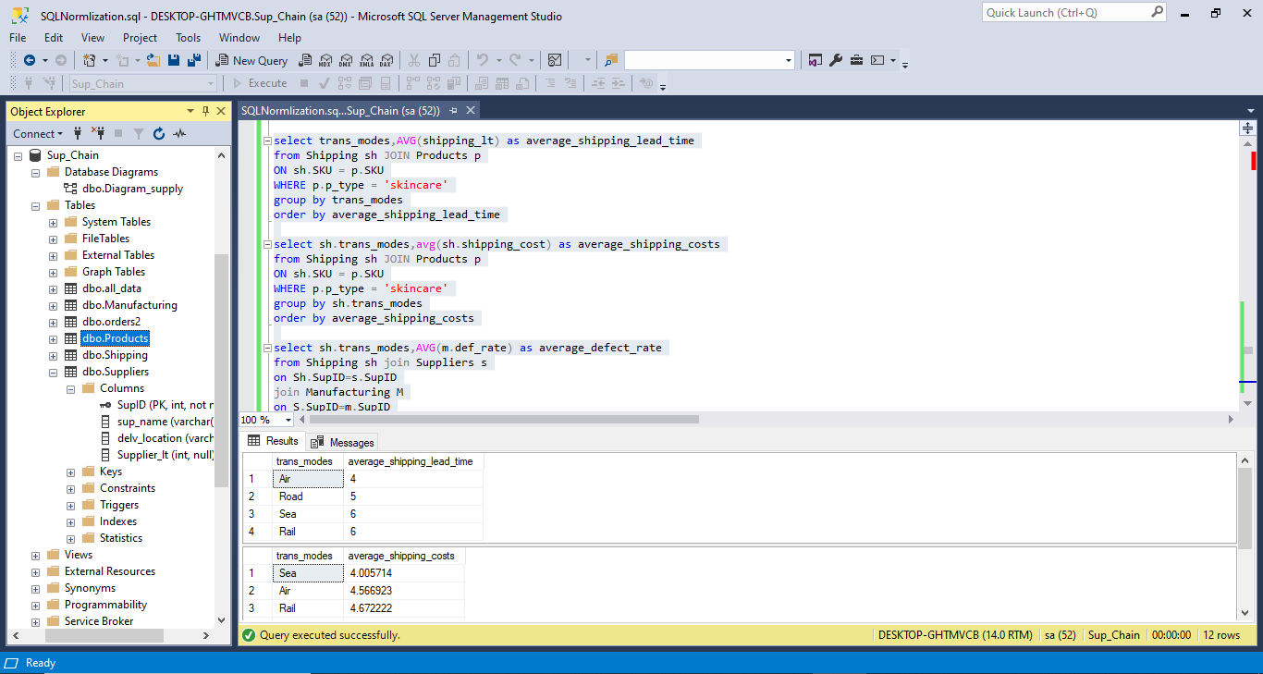

5
Analysis Questions

Slide 22
5
Analysis Questions
Further analysis:
We wanted to calculate normal KPI, such as:
1- Cash to Cash Cycle Time
2- Perfect Order Rate
3- Fill Rate
4- Inventory Turnover Rate
No data on: Order Date, Period of data, completed orders, returns, errors, beginning inventory, ending inventory .
Forecasting

Slide 23
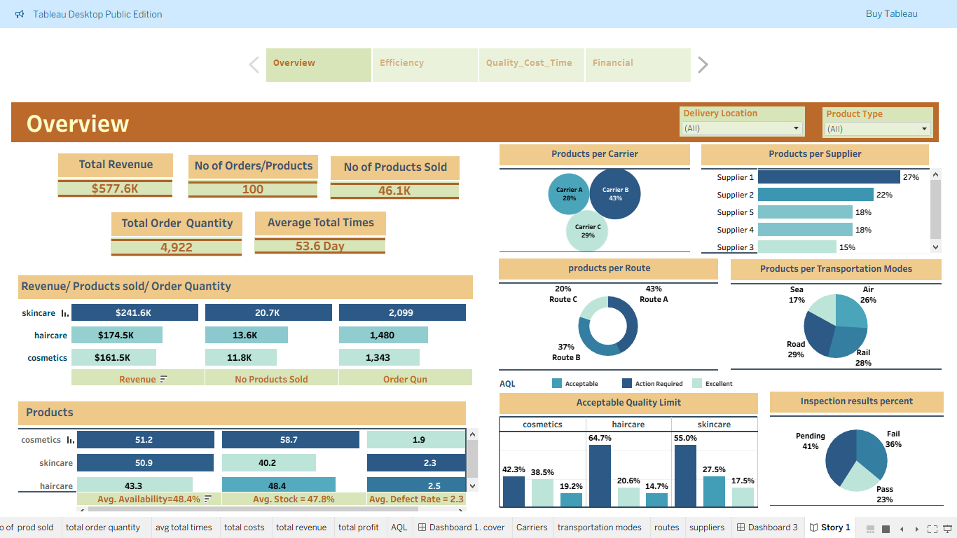
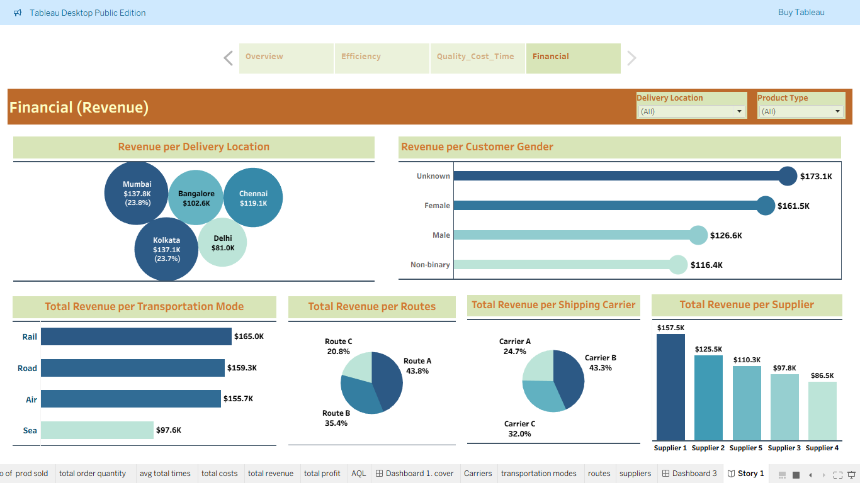
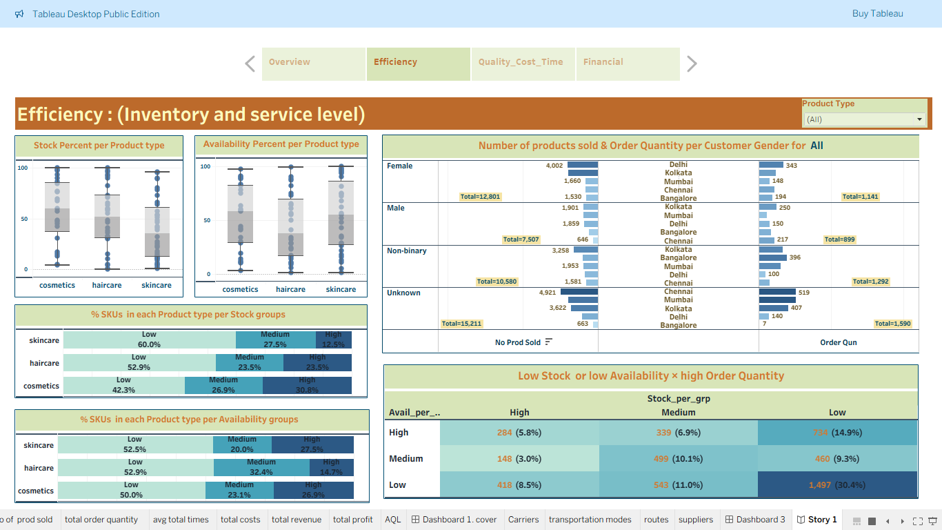
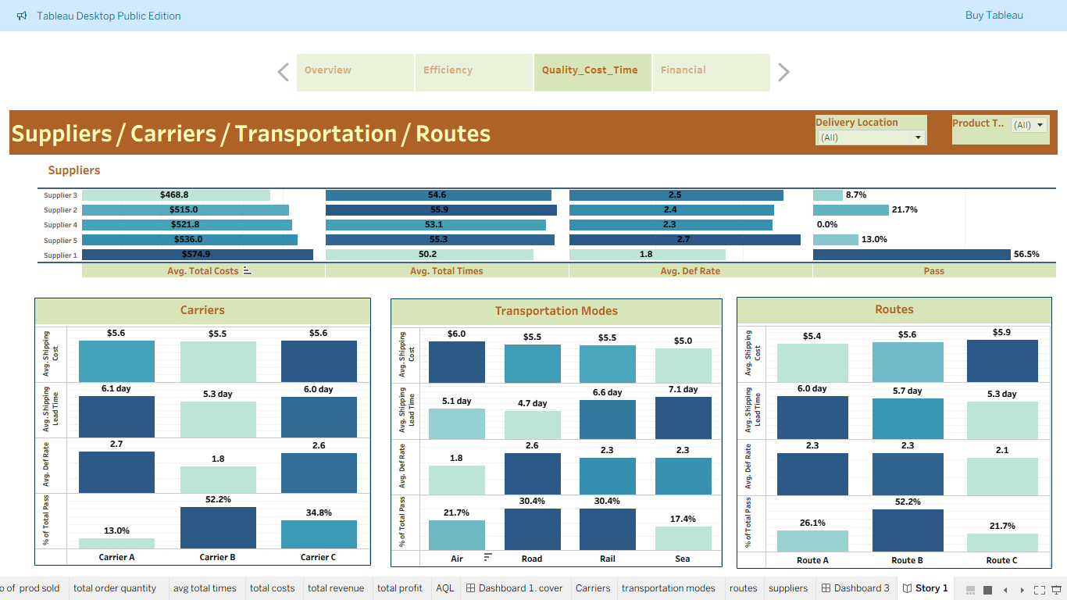
6-Visualization

Slide 24
1
Conclusions
Average defect rate
(cosmetics 1.9 – haircare 2.5 – skincare 2.3). (medical/personal care products=health and safety risks) Acceptable Quality Limit (AQL) standard (<1 excellent – 1-2 acceptable - >2 actions required). Pass percent 23%
2
3
4

Slide 25
Conclusions
2
Suppliers-Carriers-Transport-Route
Cosmetics: best (Supplier 1 -Carrier B – Transportation Air – Route C) - Skincare: best (Supplier 1 -Carrier B – Transportation Air – Route B) - Haircare: best (Supplier 3 -Carrier B – Transportation Rail – Route C)
1
3
4

Slide 26
Conclusions
3
Skincare best product type. Although lowest stock level, highest Pass 28%, highest orders, highest revenue
1
2
4

Slide 27
Conclusions
4
3
1
2
Highest demand Locations
Kolkata highest demand for skincare and haircare, while Delhi for cosmetic.

Slide 28



Recommendations

Slide 29

Recommendations
1- Reduce defect rate:
increase quality (row materials – manufacturing) – environment standards manufacturing, warehousing, shipping (temperature - lighting) – reduce lead times (warehousing closer to markets) – Tracking system (audit/monitoring)

Slide 30

Recommendations
2- Selecting (Supplier- Carrier- transportation- Route) based on Product Quality and Time (even high costs). (reduces costs rework, replacements, and compensations)

Slide 31

Recommendations
3- Skincare
needs more production for safety stock level.

Slide 32

Recommendations
4- Manage stock with rapid replenishment-Locations to optimize fulfillment skincare and haircare for Kolkata, cosmetics for Delhi

Slide 33
Recommendations
5- Unknown gender cases can be avoided by validation rule before entering data. Customers-Lack of targeted marketing

Slide 34
Deliverables
Loaded Files on GitHub:
1- Presentation
2- Documentation PDF
3- Final Notebook
4- Final SQL
5- Final Tableau
6- Original data CSV file
7- Excel data file
GitHub Link:
https://github.com/OmarAhmedAI/DEPI-Project

Slide 35
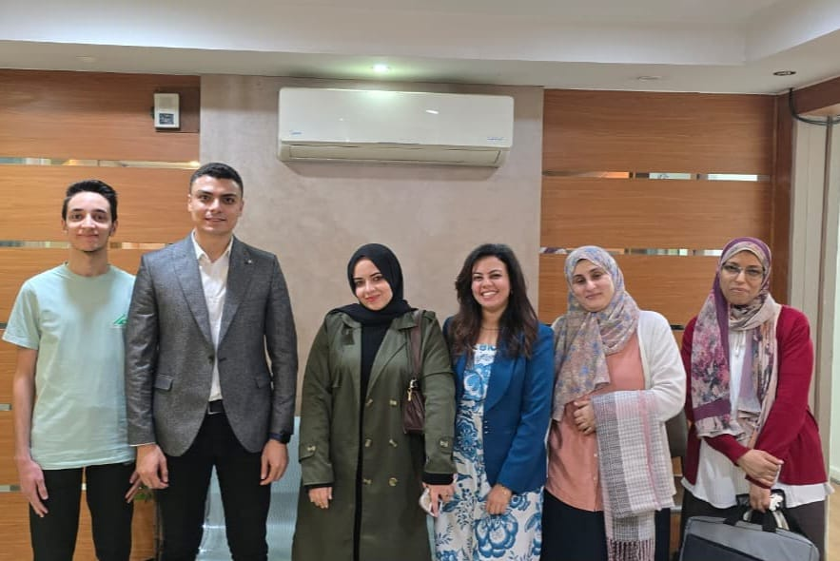
Thanks to MCIT and DEPI
We would like to extend our sincere gratitude to Eng. Ahmed Samir , our Data Analysis instructor, for his exceptional leadership and professionalism throughout the past six months. His guidance and expertise have been instrumental in shaping our understanding and approach to analytical thinking.
We also deeply appreciate the dedication and collaborative spirit of our project team, whose consistent effort and commitment made this achievement possible.

Slide 36

Thanks For Challenge Team:
Doaa
Mervat
Monica
Reham
Omar
Thanks for your
interest
and
valuable questions.

